Slide 1
Amortized analysis
Session 13
Henry Lucky, S.Kom. M.Kom.

Slide 2
Outline Materials
Session 13
Amortized analysis
Aggregate Analysis
The accounting method
The potential method
Dynamic Tables

Slide 3
Learning outcomes
LO 1: Explain fundamental concept of analysis algorithms
LO 2: Apply algorithm techniques and methods
LO 3: Solve a problem using specific algorithm.
LO 4: Compare several algorithm design methods

Slide 4
Amortized Analysis
Definition
Key point: The time required to perform a sequence of data structure operations is averaged over all operations performed
Amortized analysis can be used to show that:
The average cost of an operation is small
If one averages over a sequence of operations
even though a single operation might be expensive

Slide 5
Amortized Analysis
Amortized Analysis vs Average Case Analysis
Amortized analysis does not use any probabilistic reasoning
Amortized analysis guarantees the average performance of each operation in the worst case

Slide 6
Amortized Analysis
Techniques
The most common three techniques
The aggregate analysis
The accounting method
The potential method
If there are several types of operations in a sequence
The aggregate analysis assigns
The same amortized cost to each operation
The accounting method and the potential method may assign
Different amortized costs to different types of operations

Slide 7
The Aggregate Analysis
Definition
Show that sequence of n operations takes
Worst case time T(n) in total for all n
The amortized cost (average cost in the worst case) per operation is therefore T(n)/n
This amortized cost applies to each operation
Even when there are several types of operations in the sequence

Slide 8
The aggregate analysis
Multipop stack
PUSH(S, x): pushed object x onto stack
POP(S): pops the top of the stack S and returns the
popped object
MULTIPOP(S, k): removes the k top objects of the stack S or pops the entire stack if | S | < k
PUSH and POP runs in Θ(1) time
The total cost of a sequence of n PUSH and POP operations is therefore Θ(n)
The running time of MULTIPOP(S, k) is
Θ(min(s, k)) where s = | S |

Slide 9
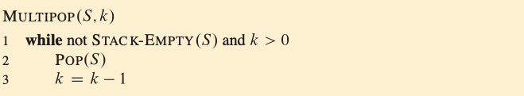
The aggregate analysis
Multipop stack
Running time:
Θ(min(s, k)) where s = | S |

Slide 10
The Aggregate Analysis
Multipop stack
Let us analyze a sequence of n PUSH, POP, and MULTIPOP operations on an initially empty stack
The worst case of a MULTIPOP operation in the sequence is O(n), since the stack size is at most n
Hence, a sequence of n operations costs O(n²)
we may have n MULTIPOP operations each costing O(n)
The analysis is correct, however,
Considering worst-case cost of each operation, it is not tight
We can obtain a better bound by using aggregate method of amortized analysis

Slide 11
The Aggregate Analysis
Multipop stack
Aggregate method considers the entire sequence of n operations
Although a single MULTIPOP can be expensive
Any sequence of n PUSH, POP, and MULTIPOP operations on an initially empty sequence can cost at most O(n)
Proof: each object can be popped once for each time it is pushed. Hence the number of times that POP can be called on a nonempty stack including the calls within MULTIPOP is at most the number of PUSH operations, which is at most n
⇒The amortized cost of an operation is the average O(n)/n = O(1)

Slide 12
The aggregate analysis
Incrementing a Binary Counter
Implementing a k-bit binary counter that counts upward from 0
Use array A[0…k−1] of bits as the counter where length[A]=k;
A[0] is the least significant bit;
A[k−1] is the most significant bit;

Slide 13
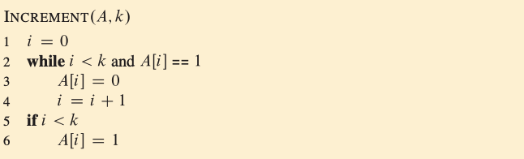
The aggregate analysis
Incrementing a Binary Counter
Initially x = 0, i.e., A[i] = 0 for i = 0,1, …, k−1
To add 1 (mod 2^{k}) to the counter, call INCREMENT procedure

Slide 14
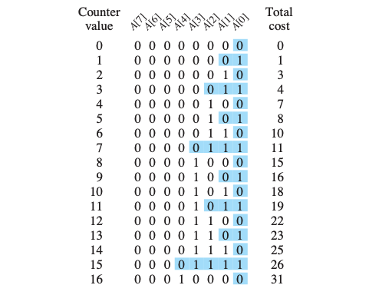
The aggregate analysis
Incrementing a Binary Counter
Bits that flip to achieve the next value are shaded

Slide 15
The aggregate analysis
Incrementing a Binary Counter
Cursory analysis:
A single execution of INCREMENT takes Θ(k) in the worst case in which array A contains all 1’s
Thus, n INCREMENT operations on an initially zero counter takes O(kn) time in the worst case. ⇦NOT TIGHT⇨

Slide 16
The aggregate analysis
Incrementing a Binary Counter
Note that, the running time of an INCREMENT operation is proportional to the number of bits flipped
However, all bits are not flipped at each INCREMENT
A[0] flips at each increment operation
A[1] flips at alternate increment operations
A[2] flips only once for 4 successive increment operations

In general, bit A[i] flips ⎣n/2^{i}⎦ times in a sequence of n INCREMENTs

Slide 17
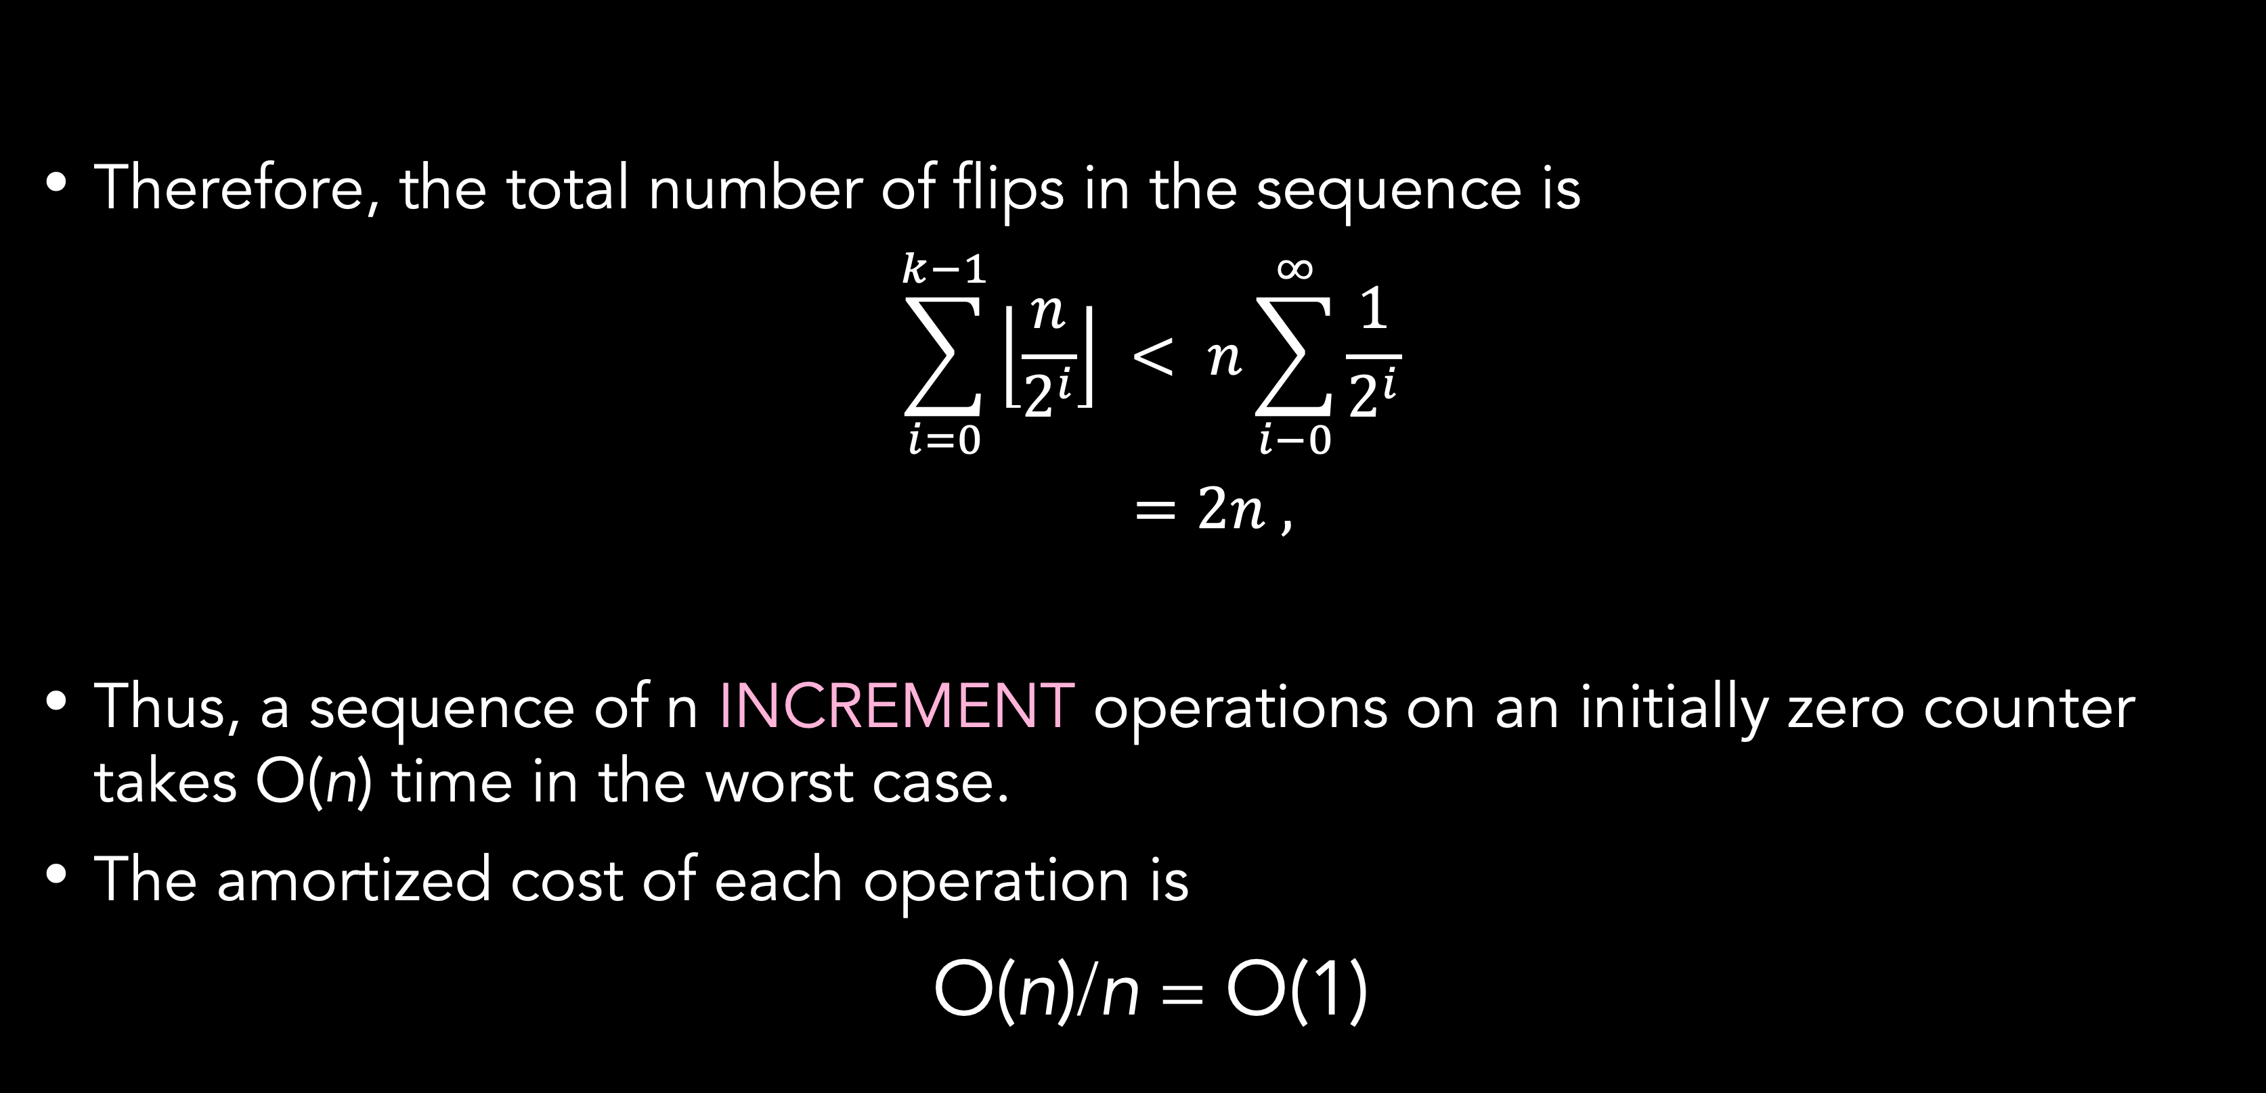
The aggregate analysis
Incrementing a Binary Counter
Therefore, the total number of flips in the sequence is
$$\sum_{i=0}^{k−1}{\left\lfloor \frac{n}{2^{i}}\right\rfloor } < n\sum_{i−0}^{∞}{\frac{1}{2^{i}}}$$
$$=2n ,$$
Thus, a sequence of n INCREMENT operations on an initially zero counter takes O(n) time in the worst case.
The amortized cost of each operation is
O(n)/n = O(1)

Slide 18
The Accounting Method
Definition
We assign different charges to different operations with some operations charged more or less than they actually cost
The amount we charge an operation is called its amortized cost
When the amortized cost of an operation exceeds its actual cost the difference is assigned to specific objects in the data structure as credit
Credit can be used later to help pay for operations whose amortized cost is less than their actual cost
That is, amortized cost of an operation can be considered as being split between its actual cost and credit (either deposited or used)

Slide 19
The Accounting Method
Definition
Key points in the accounting method:
The total amortized cost of a sequence of operations must be an upper bound on the total actual cost of the sequence
This relationship must hold for all sequences of operations
Thus, the total credit associated with the data structure must be nonnegative at all times
Since it represents the amount by which the total amortized cost incurred so far exceed the total actual cost incurred so far

Slide 20
The Accounting Method
Multipop stack
Assign the following amortized costs:
Push: 2 Pop: 0 Multipop: 0
Notes:
Amortized cost of MULTIPOP is a constant (0), whereas the actual cost is variable
All amortized costs are O(1), however, in general, amortized costs of different operations may differ asymptotically
Suppose we use $1 bill to represent each unit of cost

Slide 21
The Accounting Method
Multipop stack
We start with an empty stack of plates
When we push a plate on the stack
we use $1 to pay the actual cost of the PUSH operation
we put a credit of $1 on top of the pushed plate
At any time point, every plate on the stack has a $1 of credit on it
The $1 stored on the plate is a prepayment for the cost of popping it
In order to pop a plate from the stack
we take $1 of credit off the plate
and use it to pay the actual cost of the POP operation

Slide 22
The Accounting Method
Multipop stack
Thus, by charging the PUSH operation a little bit more we don’t need to charge anything from the POP & MULTIPOP operations
We have ensured that the amount of credits is always nonnegative
since each plate on the stack always has $1 of credit
and the stack always has a nonnegative number of plates
Thus, for any sequence of n PUSH, POP, MULTIPOP operations, the total amortized cost is an upper bound on the total actual cost
Since the total amortized cost is O(n), so is the total actual cost.

Slide 23
The Accounting Method
Incrementing a binary counter
Recall that, the running time of an INCREMENT operation is proportional to the number of bits flipped
Charge an amortized cost of $2 to set a bit to 1
When a bit is set
we use $1 to pay for the actual setting of the bit and
we place the other $1 on the bit as credit
At any time point, every 1 in the counter has a $1 of credit on it
Hence, we don’t need to charge anything to reset a bit to 0, we just pay for the reset with the $1 on it.

Slide 24
The Accounting Method
Incrementing a binary counter
The amortized cost of INCREMENT can now be determined:
The cost of resetting bits within the while loop is paid by the dollars on the bits that are reset
At most one bit is set to 1, in an INCREMENT operation
Therefore, the amortized cost of an INCREMENT operation is at most $2
The number of 1’s in the counter is never negative, thus
the amount of credit is always nonnegative
Thus, for n INCREMENT operations, the total amortized cost is O(n), which bounds the actual cost

Slide 25
The Potential Method
Definition
Accounting method represents prepaid work as credit stored with specific objects in the data structure
Potential method represents the prepaid work as potential energy or just potential
that can be released to pay for the future operations
The potential is associated with the data structure as a whole rather than with specific objects within the data structure

Slide 26
The Potential Method
Definition
We start with an initial data structure D₀ on which we perform n operations
For each i =1, 2, …, n, let
C_{i}: the actual cost of the i-th operation
D_{i}: data structure that results after applying i-th operation to D_{i−1}
φ : potential function that maps each data structure D_{i} to a real number φ (D_{i})
φ (D_{i}): the potential associated with data structure D_{i}
_{i}: amortized cost of the i-th operation w.r.t. function φ

Slide 27
The Potential Method
Definition
actual increase in potential
cost due to the operation
The total amortized cost of n operations is

Slide 28
The Potential Method
Definition
If we can ensure that φ (D_{n}) ≥ φ (D₀) then
the total amortized cost gives an upper bound on the total actual cost
Hence, if we require that φ (D_{i}) ≥ φ (D₀), for all i, then we ensure that we pay in advance (as in the accounting method)

Slide 29
The Potential Method
Definition
If φ (D_{i}) −φ (D_{i−1}) > 0, then the amortized cost _{i} represents
an overcharge to the i-th operation and
the potential of the data structure increases
If φ (D_{i}) − φ (D_{i−1}) < 0, then the amortized cost _{i} represents
an undercharge to the i-th operation and
the actual cost of the operation is paid by the decrease in potential
Different potential functions may yield different amortized costs which are still upper bounds for the actual costs
The best potential fn. to use depends on the desired time bounds

Slide 30
The Potential Method
Multipop stack
Define φ (S)=| S |, the number of objects in the stack
For the initial empty stack, we have φ (D₀) = 0
Since |S| ≥ 0, stack D_{i} that results after ith operation has nonnegative potential for all i, that is
φ (D_{i}) ≥ 0 = φ (D₀) for all i
total amortized cost is an upper bound on total actual cost
Let us compute the amortized costs of stack operations where ith operation is performed on a stack with s objects

Slide 31
The Potential Method
Multipop stack
PUSH (S): φ (D_{i}) − φ (D_{i−1}) = (s +1) − (s) = 1
MULTIPOP(S, k): φ (D_{i}) −φ (D_{i−1}) = − k' = − min{s, k}
POP (S):
The amortized cost of each operation is O(1), and thus the total amortized cost of a sequence of n operations is O(n)
ˆ
C_{i} = C_{i} + φ (D_{i}) −φ (D_{i−1}) = 1 + 1 = 2
ˆ
C_{i} = C_{i} + φ (D_{i}) −φ (D_{i−1}) = k' − k' = 0
ˆ
C_{i} = 0, similarly

Slide 32
The Potential Method
Incrementing a binary counter
Define φ (D_{i}) =b_{i}, number of 1s in the counter after the ith operation
Compute the amortized cost of an INCREMENT operation wrt φ
Suppose that ith INCREMENT resets t_{i} bits then,
t_{i} ≤ C_{i} ≤ t_{i} +1
The number of 1s in the counter after the ith operation is
b_{i−1}− t_{i} ≤ b_{i} ≤ b_{i−1}− t_{i} +1 ⇒ b_{i} − b_{i−1} ≤ 1− t_{i}
The amortized cost is therefore
ˆ
C_{i} = C_{i} + φ (D_{i}) −φ (D_{i−1}) ≤ (t_{i} +1) + (1− t_{i}) = 2

Slide 33
The Potential Method
Incrementing a binary counter
If the counter starts at zero, then φ (D₀) = 0.
Since φ (D_{i}) ≥ 0 for all i the total amortized cost is an upper bound on the total actual cost
Hence, the worst-case cost of n INCREMENT operations is O(n)

Slide 34
The Potential Method
Incrementing a binary counter
Assume that the counter does not start at zero, i.,e., b₀≠0
Then, after n INCREMENT operations the number of 1s is b_{n}, where 0 ≤ b₀, b_{n} ≤ k
Since b₀ ≤ k, if we execute at least n = Ω(k) INCREMENT operations the total actual cost is O(n)
No matter what initial value the counter contains
n
n
n
ˆ
Σ C_{i} = Σ C_{i} − φ (D_{n}) + φ (D₀) ≤ Σ 2−b_{n}+b₀
= 2n−b_{n}+b₀
i = 1
i = 1
i = 1

Slide 35
Dynamic table
Definition
When you design an application that uses a table, you do not always know in advance how many items the table will hold.
Dynamic tables with the ability to dynamically expanding and contracting a table is used.
Support operations: TABLE-INSERT and TABLE-DELETE.
Scenario:
A table –maybe a hash table/stack/heap
Do not know how large in advance
May expend with insertion
May contract with deletion
Goal:
O(1) amortized cost of insertion and deletion.
Unused space always ≤ constant fraction of allocated space.

Slide 36
Summary
With amortized analysis, you show that if you average over a sequence of operations, then the average cost of an operation is small, even though a single operation within the sequence might be expensive.
There are 3 methods for amortized analysis: aggregate, accounting, and potential.
In aggregate analysis, you determine an upper bound T(n) on the total cost of a sequence of n operations.
In accounting method, you determine an amortized cost of each operation where each may have a different amortized cost.
The potential method is like the accounting method, however it maintains the credit as the “potential energy” of the data structure as a whole instead of associating the credit with individual objects within the data structure.

Slide 37
Exercises
13
If the set of stack operations includes a MULTIPUSH operation, which pushes k items onto the stack, does the O(1) bound on the amortized cost of stack operations continue to hold?
Use aggregate analysis, accounting method, and potential method to determine the amortized cost per operation for a sequence of n operations on a data structure in which the ith operation costs i if i is an exact power of 2, and 1 otherwise.

Slide 38
References
Thomas H. Cormen. (2022). Introduction to algorithms: Fourth edition. The MIT Press. Chapter 16.

Slide 39
Thank you
Amortized analysis
September, 2023

